Slide 1
Activity Counter
Lab 2
By Socheath Sok

Slide 2
Overview
Introduction
Sleep Mechanism
Sleep Stages
Devices
Mechanical Pedometer
Accelerometer (ADXL335)
Schematic
Result
Limitations and Improvements
References

Slide 3
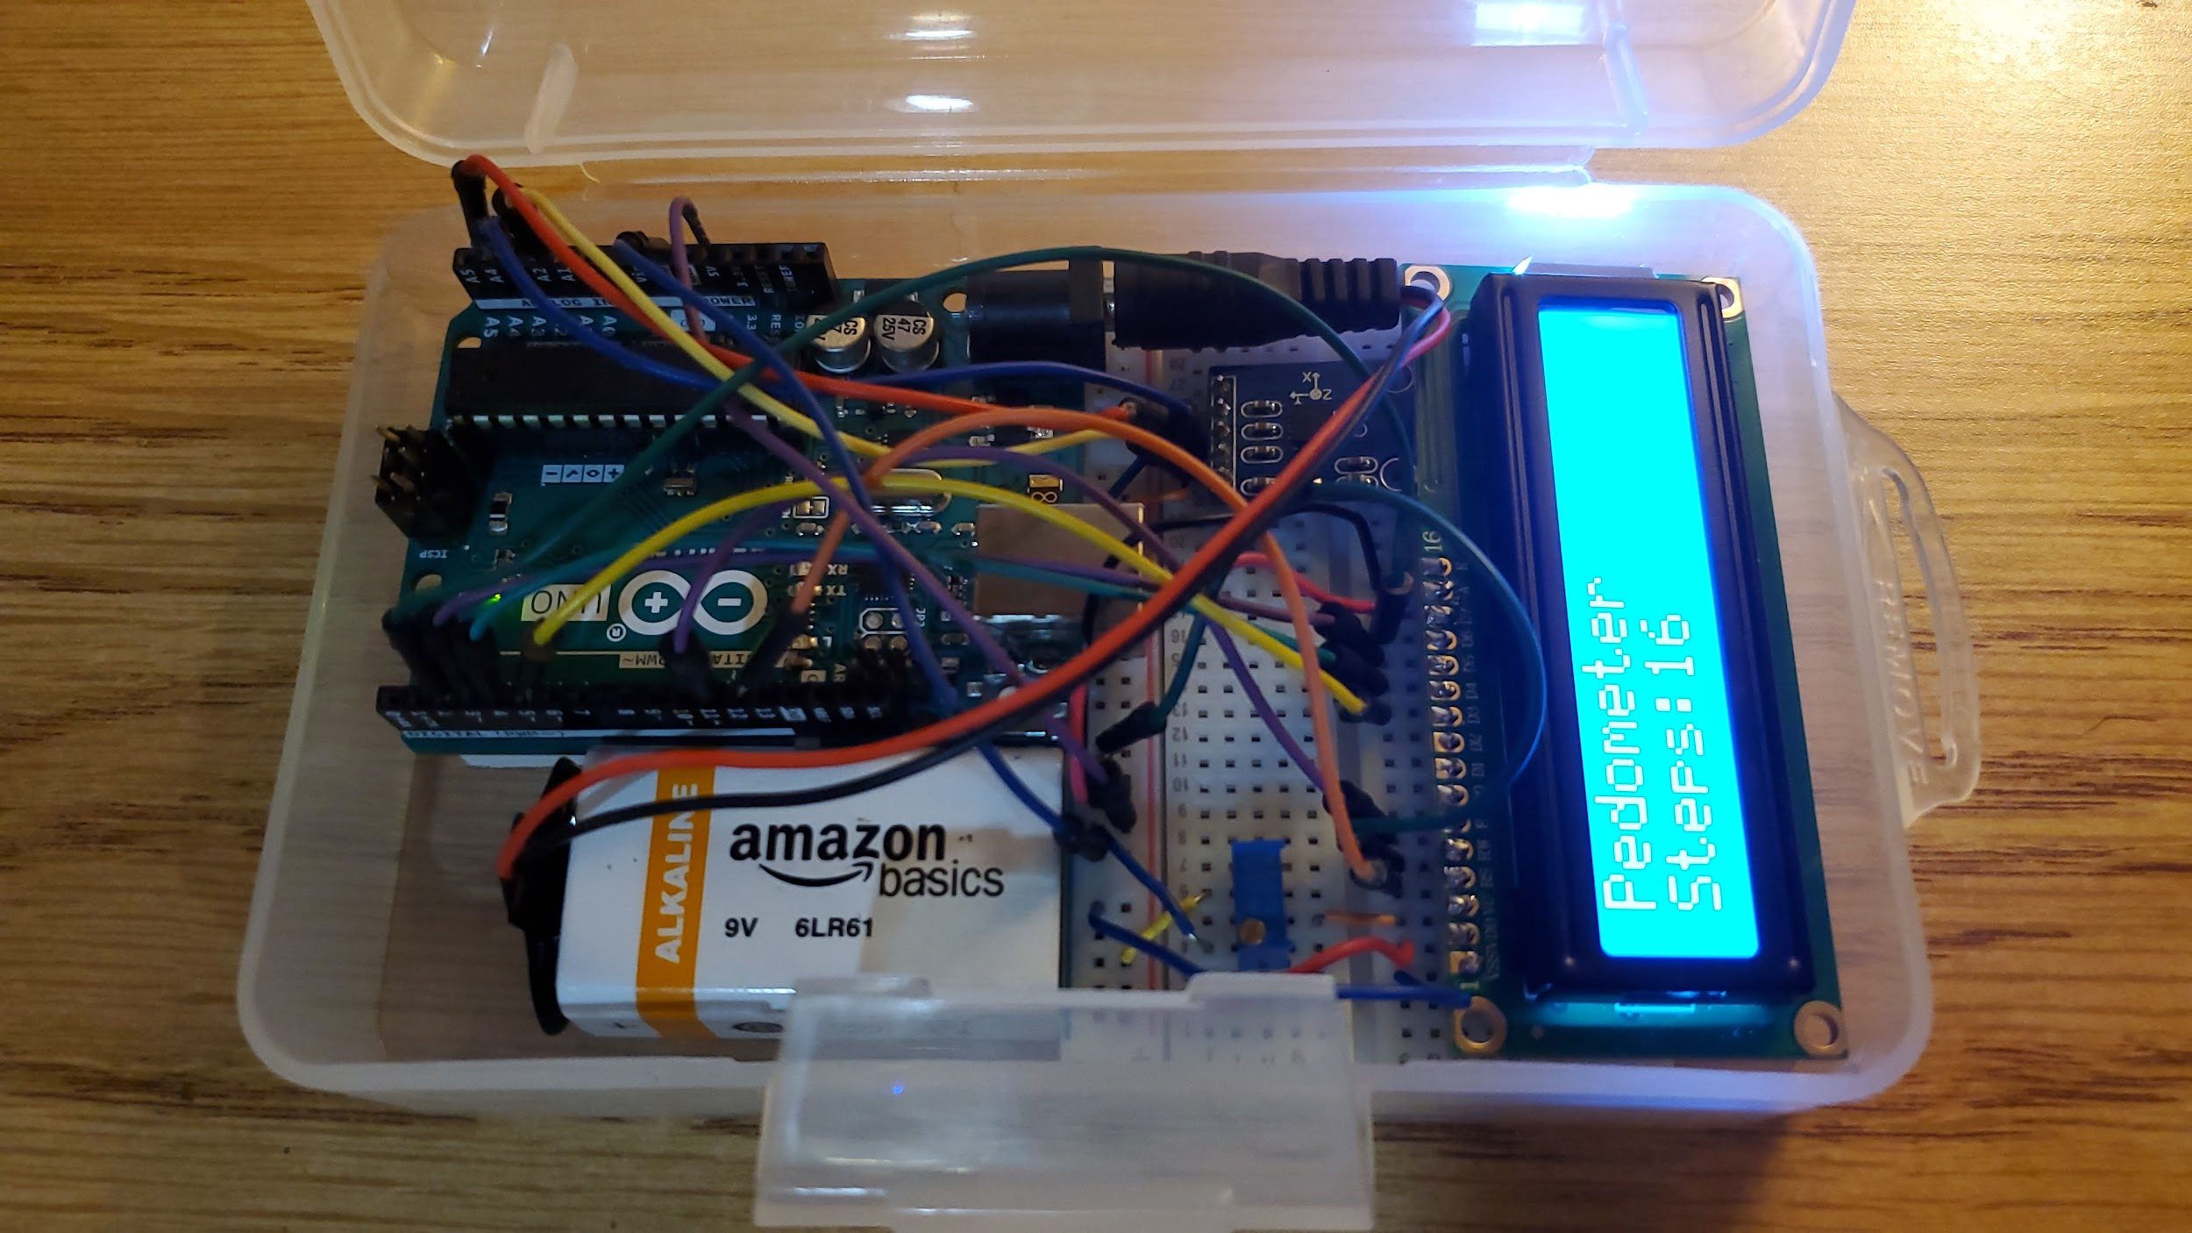

Slide 4
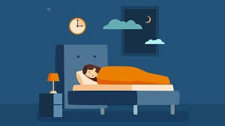
Introduction
Sleep is an important part of our daily routine
Help removes toxins in the brain
Allow the brain to:
Learn and create new memories
Concentrate and response quickly
Lack of sleep increases the risk of disorders
High blood pressure, diabetes, depression, etc
[1]
Notes:
Cardiovascular disease, obesity

Slide 5
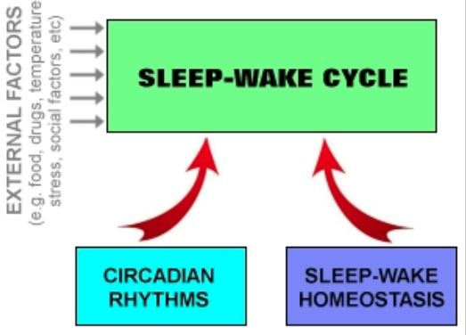
Sleep Mechanism
Circadian Rhythms (“Biological Clock”)
Control the timing of sleep
Synchronize with environmental cues
Homeostasis
Keep track of the need for sleep
Regulate sleep intensity
Sleep cycle can be affected by many factors
Medication, stress, sleep environment, etc
[1]
Notes:
work together to regulate when you are awake and sleep.
environmental cues (light, temperature) about the actual time of day, but they continue even in the absence of cues.

Slide 6
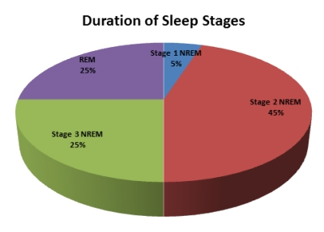
Sleep Stages
Stage 1: changeover from wakefulness to sleep
Muscles begin to relax and brain waves begin to slow down
Stage 2: Light sleep
Muscles relax further, temperature drops, & eye movements stop
Stage 3: deep sleep
Heartbeat and breathing slow to their lowest levels
REM: Rapid Eye Movement phase (where dream occurs)
Brain become active, heartbeat and blood pressure rise
[1]
Notes:
spend more of your repeated sleep cycles in stage 2 sleep than in other sleep stages.

Slide 7
Devices
The average person tossed and turned 37 to 40 times each night.
Sleep activity can be tracked using
Pedometer: $1
Similar to a pendulum
Hammer swings across and touches a metal, completing the circuit and allowing current to flow
[3]

Slide 8
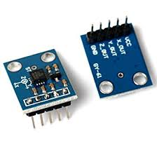
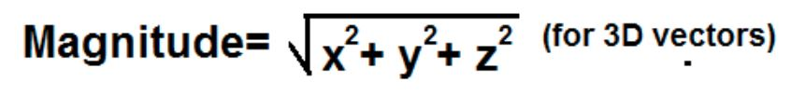
ADXL 335 ($15)
2. Accelerometer
ADXL335
3 axis sensing
+/- 3 G force
Low power and excellent temperature stability
Commonly used in electronic devices
Fitbit watches: $100 to $300
Smartphones: $500 to $1200
[2]

Slide 9
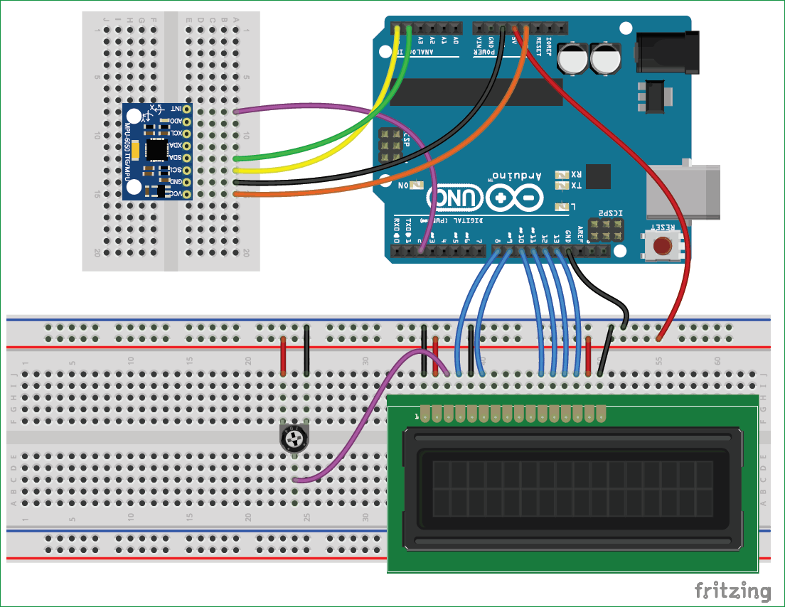
Schematic
[2]

Slide 10
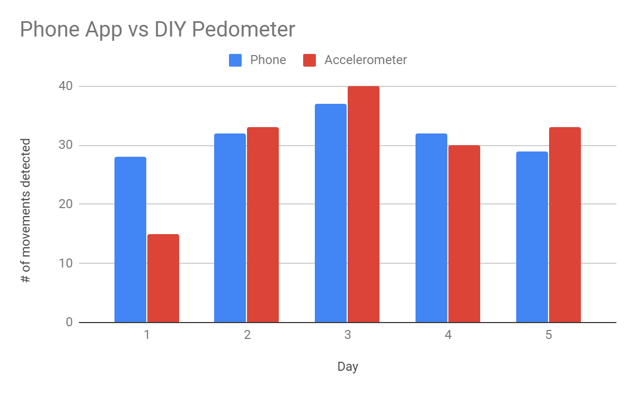
Result

Slide 11
Limitations & Possible Improvements
Manual Calibration
Unstable Connection
Cannot handle rapid movements
Limited Information
Battery life
Change into a wearable device
Replace the Uno with Nano or Pico
Rechargeable battery
Make a phone app
Record the activities and divide into different sleep stages

Slide 12
References
[1] “Brain Basics: Understanding Sleep.” National Institute of Neurological Disorders and Stroke, U.S. Department of Health and
Human Services, https://www.ninds.nih.gov/disorders/patient-caregiver-education/understanding-sleep.
[2] Instructables. “Simple, Easy and Cheap DIY Pedometer With Arduino.” Instructables, Instructables, 15 Oct. 2017,
https://www.instructables.com/id/Simple-Easy-and-Cheap-DIY-Pedometer-with-Arduino/.
[3] Woodford, Chris. “How Do Pedometers Work?” Explain That Stuff, 24 Sept. 2018,
https://www.explainthatstuff.com/how-pedometers-work.html.

